Slide 1
Student marks prediction
ML project CO-327
By:- Yash Saini
Roll no:- 2K18/EC/195
Submitted to:- Mrs Juhi Jain

Slide 2
Motivation
To reduce burden from those students who couldn’t able give exams
Students should be given a choice to choose whether to go with a retest or go with the marks predicted by the model itself.
Eg:-
1st yr :- 8.4
2nd yr :- 8.6
3rd yr :- 6.0
4th yr :- 8.4

Slide 3
Objective
To predict CGPA using Linear Regression model.
Training the model with the previous cg of students and building a LR model with different cost function for different branches.

Slide 4
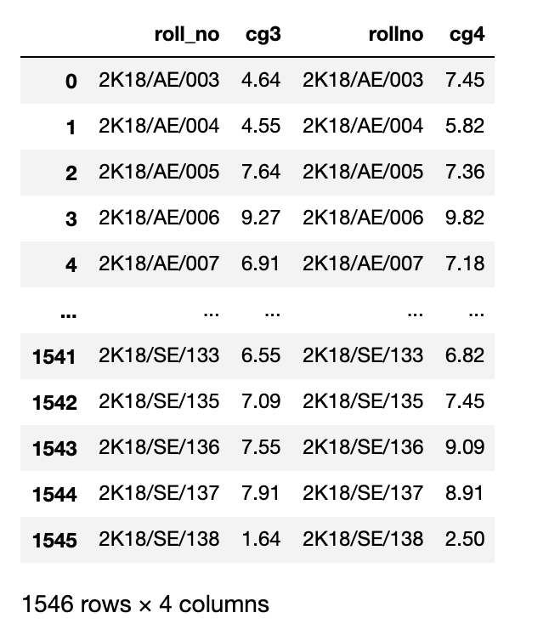
4.1 :- Dataset
Dataset comprised of around 1500 students
With there roll number and 3rd and 4th
semester cgpa.
Branch:- AE,BT,CO,EC,EN,EP,
IT,MC,ME,PE,PS,SE

Slide 5
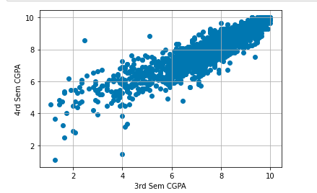
4.2 Research Variable :-
Independent variable :- 3rd Sem cgpa, also 1st and 2nd cgpa be added for prediction.
Dependent variable :- 4th sem cgpa.
4.3 Diagram :-
Distribution is same for all
the branches

Slide 6
4.4 Preprocessing and Data analysis techniques
Handling missing values and instance with less than 1 cgpa.
Scatter plot to visualize dataset
Density plot to visualize the accuracy and performance of students’

Slide 7
5 Research Methodology
Creating Data set
(PDF to CSV file)
Performance Measures
RMSE (Root Mean Square Error)
MSE (Mean Square Error)
RMSE (Root Mean Square Error)
Data Preprocessing
1. Removing missing values and cgpa < 1
2. Visualization plots
Making Predictions
Using the trained model to make predictions
Model Validation
Testing set(30%)
Training set(70%)
Model Development
Preparing the Linear Regression model

Slide 8
5.1 Data Preprocessing techniques
Handling missing values :- Removing the entire row if any of the cgpa is missing.
Removing rows with cg less than 1
Scatter plot to visualize distribution of grades based on different branch
Histogram plot to visualize difference of grades in both semesters

Slide 9
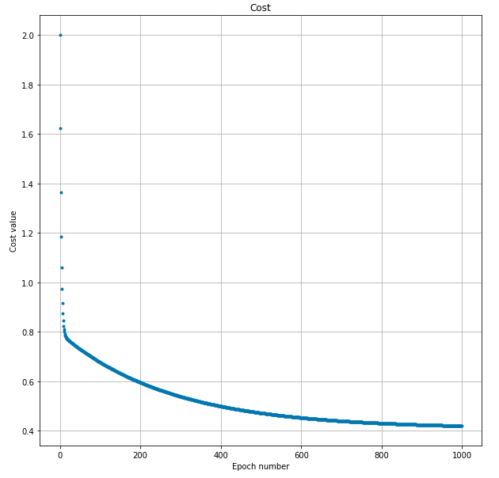
5.2 Data Analysis
Used Gradient Descent to minimize the cost function.

Slide 10
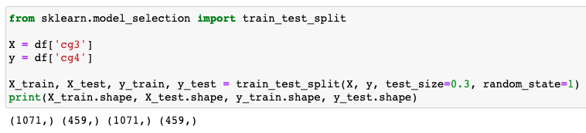
5.3 Validation Techniques
Split data into training and testing set in the ratio of 7:3

Slide 11
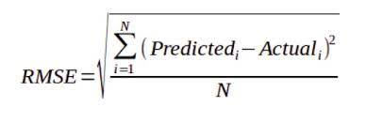
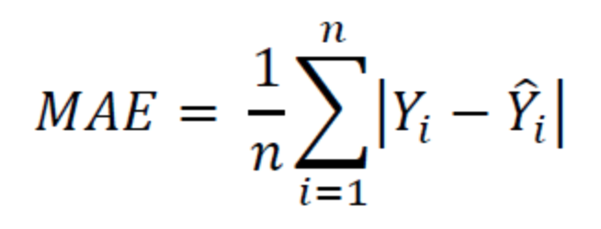
5.4 Performance Measures
RMSE :- Root Mean Squared Error
MAE :- Mean Absolute error

Slide 12
R2 Score:- The proportion of the variance in the dependent variable that is predictable from the independent variable
Formula :- total Variance explained by model/ Total Variance
MBE :- Mean bias error, mean of difference between the actual value and predicted values
Formula :- (y_test - y_pred).mean()

